Slide 1
Verification and Validation -> Verification

Slide 2
 | Verification | Validation
Definition | Evaluating work-products -> do they meet requirements | Evacuating software -> so it satisfies specified business requirements.
Looks at | Artifacts NOT its operation | Operation (not artifacts)
Question | Are we building the product right? | Are we building the right product?
Evaluation Items | Plans, Requirement Specs, Design Specs, Code, Test Cases | The actual product/software.
Activities | Reviews Walkthroughs Inspections | Testing

Slide 3

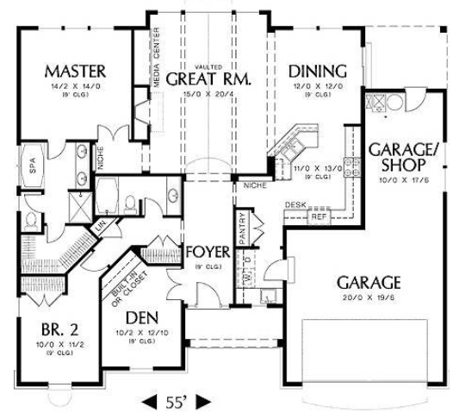
Validation – it’s a 2 room house that meets this spec
Verification – 16’’ on center?
Electric up to code? Plumbing?

Slide 4
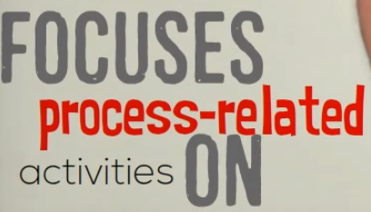
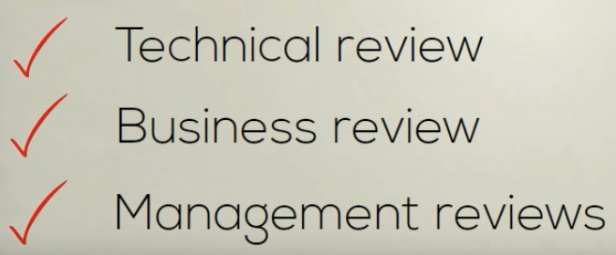
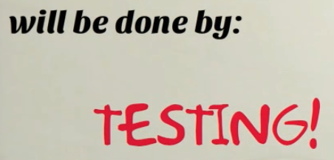
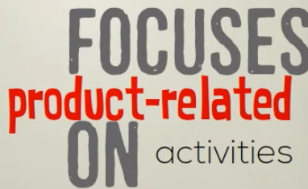
Software Quality control - Verification vs validation - https://en.wikipedia.org/wiki/Software_verification_and_validation
https://www.youtube.com/watch?v=PVmxp7BG5I4
To ensure product meet the specified requirements before final test
Verification -> "Are we building the product right”.
Validation -> "Are we building the right product”.
The System meet customer expectations .
Does Software conform to specification
As a house conforms to its blueprints.)
Does the software do what the user realy requires ..(As a house conforms to what the owner needs and wants.)

Slide 5
Inspections and testing
Can have inspections (reviews) of code or any of these artifacts

Slide 6
Code inspections
The main purpose of code inspection is to find defects and it can also spot any process improvement if any.
Group examination of code => to find defects.
Usually not execute system.
May be applied to any representation of the system (requirements, design ,configuration data, test data, etc.).
They have been shown to be an effective technique for discovering program errors.
Inspection Advantages –
Fault dependence - errors can mask other errors. Inspections can find these issues
Partial implementations - can be inspected without additional costs. )
VS partial program need to develop specialized test harness.
Broader quality - compliance with standards, portability and maintainability.
Fagan 1976 - > 60% defects can be found from inspections
Prowell, 1999 -> 90%
Inspections -> no substitute for testing. Both are needed.
- Inspections are not as good for usability or performance issues.

Slide 7
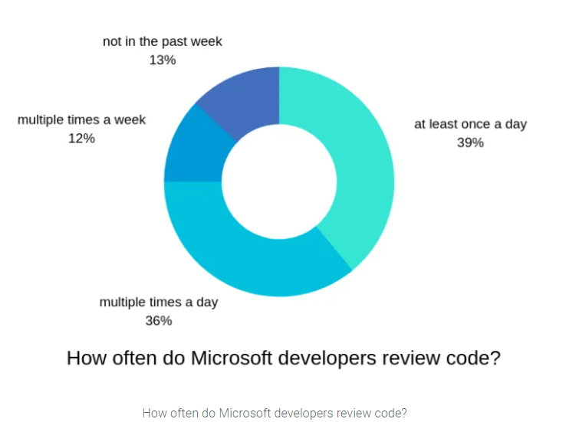
Code reviews at Microsoft
https://www.michaelagreiler.com/code-reviews-at-microsoft-how-to-code-review-at-a-large-software-company/

Slide 8
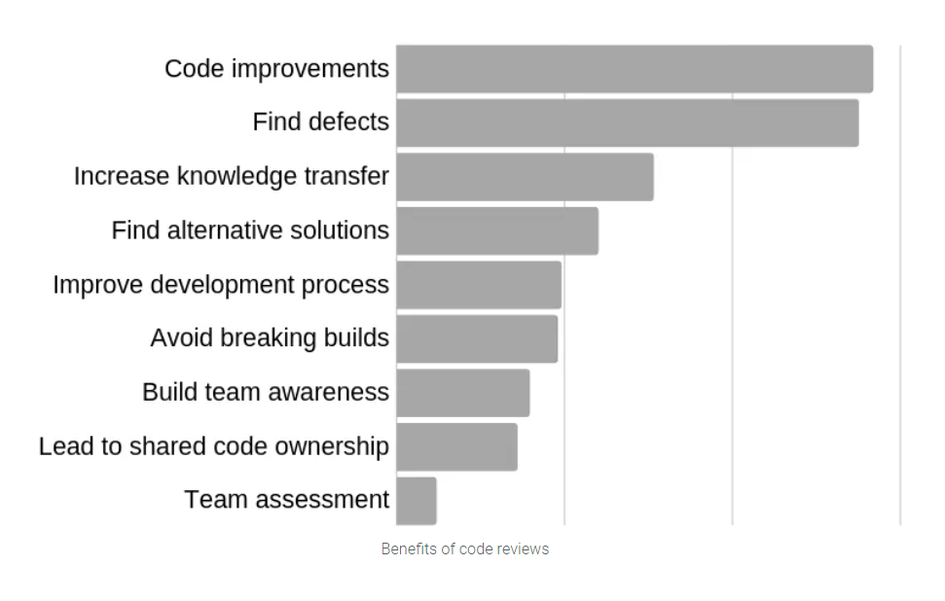
Microsoft Code reviews
Why?
improve the code quality
find defects in the code.
knowledge transfer.

Slide 9
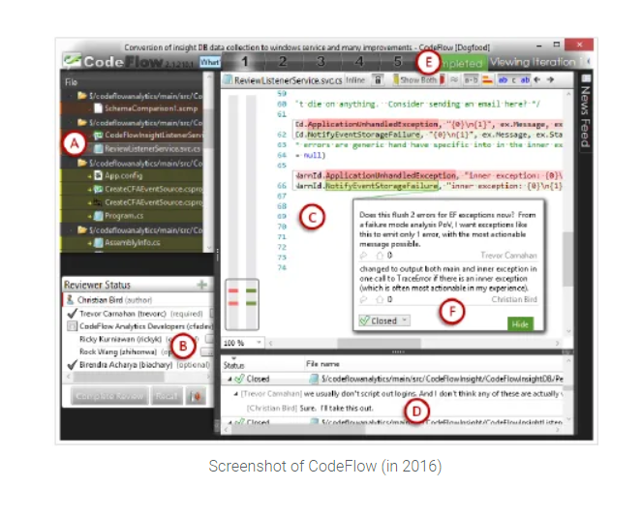
Microsoft has its own code review analytics platform
status of the code review
all affected documents
The active document is shown in the editor
1 single comment. This comment is connected to the concrete part of the code (i.e., one word in a line).
reviewers assigned to the review
a list of comments for all documents

Slide 10
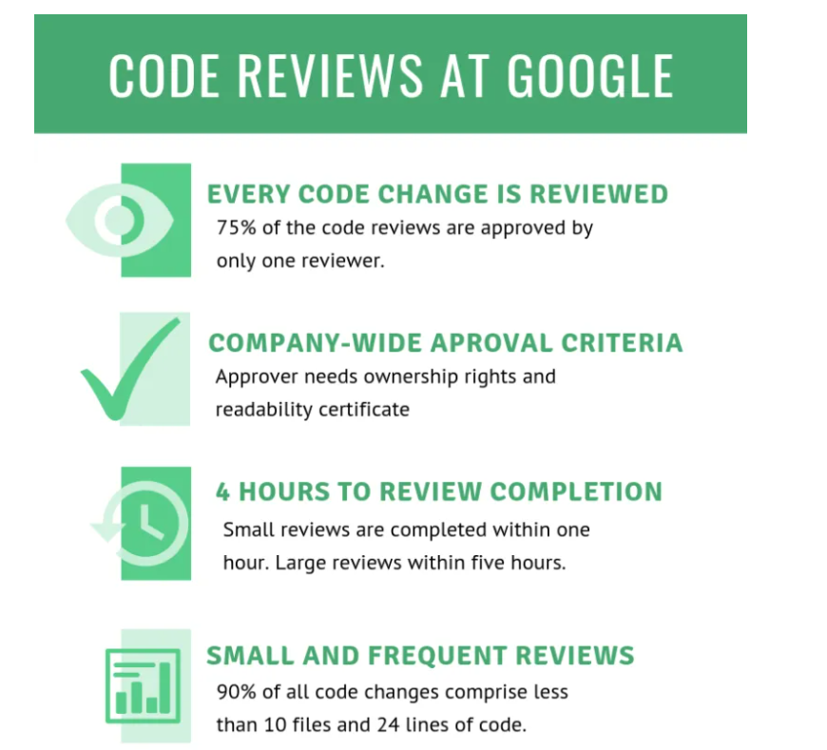
Google requires each code change to be reviewed. No exceptions. Period.
At Microsoft, on the other hand, code reviews, as well as how and what needs to be reviewed is at the discretion of the divisions or teams.
at least one person on the review must be trained in code “readability
Light and fast… >75% only 1 reviewer
Review Small and frequently
Another strict requirement is that at least one person on the review must be trained in code “readability”. What this means is that this person must have obtained a readability certification. This certification shows they’ve demonstrated they know how readable and maintainable code looks.

Slide 11
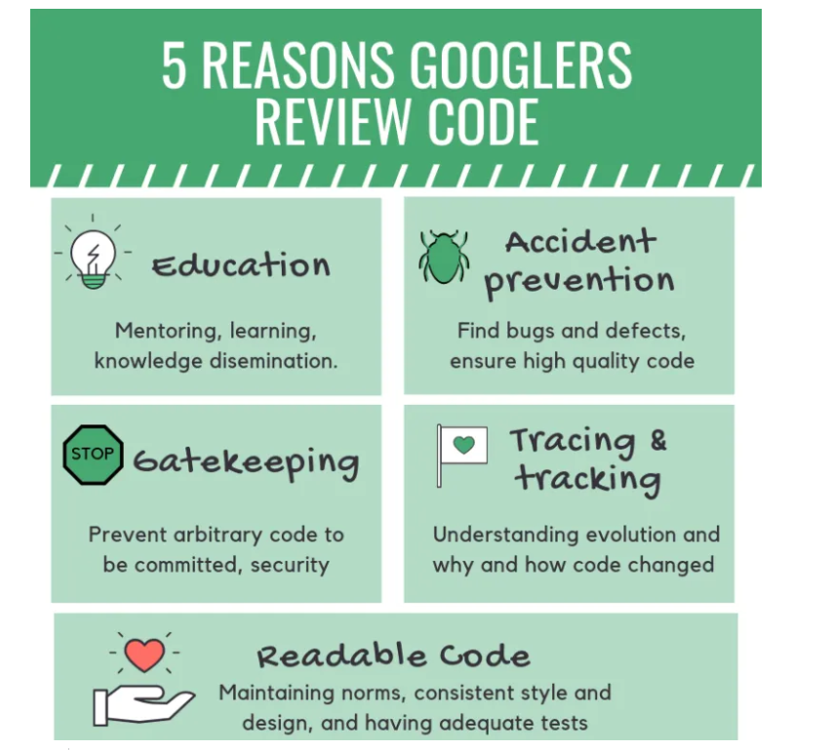
Googlers motivations for doing code reviews

Slide 12
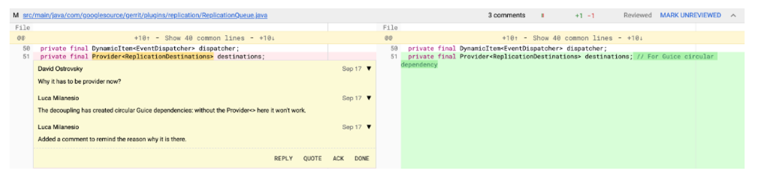
Google uses garret (integrates with Git)
https://www.gerritcodereview.com/

Slide 13
Upsource is another tool
https://www.youtube.com/watch?v=lS7E_Vbh9wQ (3:38)

Slide 14
Inspection Checklist
Often times review against programming conventions: https://google.github.io/styleguide/javaguide.html#s5.1-identifier-names
Other times have checklists: http://www.cs.toronto.edu/~sme/CSC444F/handouts/java_checklist.pdf

Slide 15
Code review goals:
Better code quality – Clean code for maintainability and readability
Defect Finding – Improve correctness, performance, security vulnerabilities, etc
Knowledge transfer – spread knowledge about the codebase, solution approaches, expectations regarding quality, etc; both to the reviewers as well as to the author
Increase Shared Responsibility – Everyone owns this
Finding better solutions – generate ideas for new and better solutions and ideas that transcend the specific code at hand.
Complying to QA guidelines – Code reviews are mandatory in some contexts, e.g., air traffic software

Slide 16
The Case for – believe that
Defect finding rate is as much as 2x most other forms of testing
evidence that up to 75% of code review defects affect software evolvability/maintainability rather than functionality,

Slide 17
A Code Review Process
Built inspection team - ~ 4 people
At least 1 is the moderator
Leads session
Records error
Ensures they get corrected
At least 1 is the dev
Material is distributed ~week before
At inspection
Dev narrates . . . Statement by statement
Participants ask questions
program is analyzed with respect to checklists of historically common programming errors (such a checklist is discussed in the next section).
Afterwards – Dev gets list of concerns
Reinspection may be warranted
Reviews are from 90-120 minutes
Expect about 150 LOC / hour
the simple act of reading aloud a program to an audience seems to be a remarkably effective error-detection technique

Slide 18
A video on Code Reviews - https://www.youtube.com/watch?v=a9_0UUUNt-Y&feature=youtu.be
What to look for in a code review
https://blog.jetbrains.com/upsource/2015/07/23/what-to-look-for-in-a-code-review/

Slide 19
Oracle Java Coding Conventions
https://www.oracle.com/java/technologies/javase/codeconventions-introduction.html
https://web.mit.edu/6.005/www/fa15/classes/04-code-review/

